Slide 1
UpToDate Anywhere
Hyeon-ah Jeong
Customer Success Specialist

Slide 2
Agenda
UpToDate is?
Why do doctors trust UpToDate?
UpToDate Redesign
UpToDate Product Demo
Q&A

Slide 3
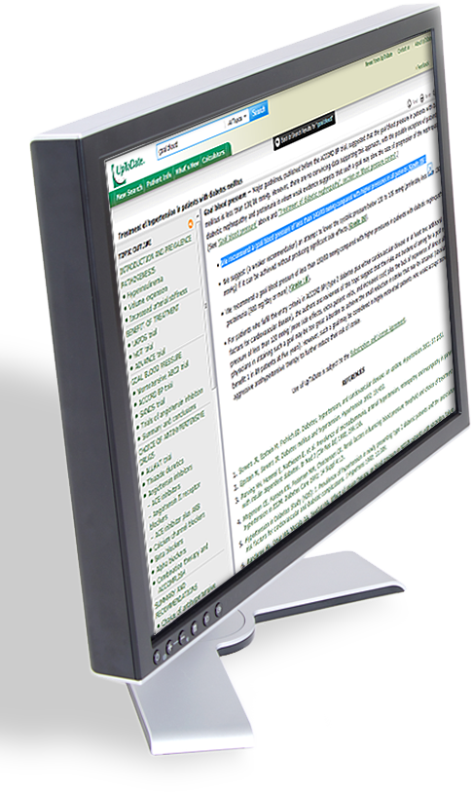
UpToDate is?
UpToDate® is an evidence-based clinical decision support system authored by physicians to help clinicians make the right decisions at the point of care.
Total users worldwide More than 1.7 million
Total institutional sites worldwide More than 37,800
Countries 191
Topic views per month More than 50 million
Topic views per year More than 550 million

Slide 4

My customers
What’s New/
Practice Changing UpDates
9,500+
11,600+
Graded Recommendation
34,000+
Clinical topics
Graphics
6,300+
185+
Drug entries
Medical calculators
1,500+
480,000+
Patient topics
Evidence links
6,900+
25
Physician authors
Specialties

Slide 5
Specialties covered by UpToDate
Allergy and Immunology
Anesthesiology
Cardiovascular Medicine
Dermatology
Emergency Medicine (Adult and Pediatric)
Endocrinology and Diabetes
Family Medicine
Gastroenterology and Hepatology
General Surgery
Geriatrics
Hematology
Hospital Medicine
Infectious Disease
Nephrology and Hypertension
Neurology
Obstetrics, Gynecology and Women’s Health
Oncology
Palliative Care
Pediatrics
Primary Care (Adult)
Primary Care Sports Medicine (Adolescents and Adult)
Psychiatry
Pulmonary and Critical Care
Rheumatology
Sleep Medicine

Slide 6
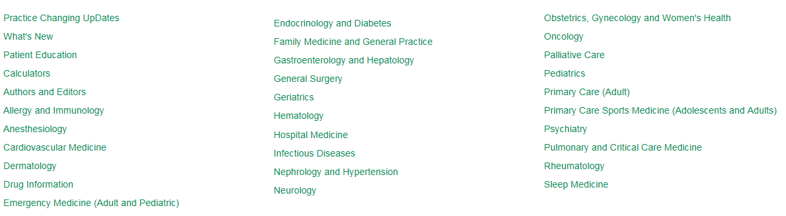
Contents in UTD

Slide 7

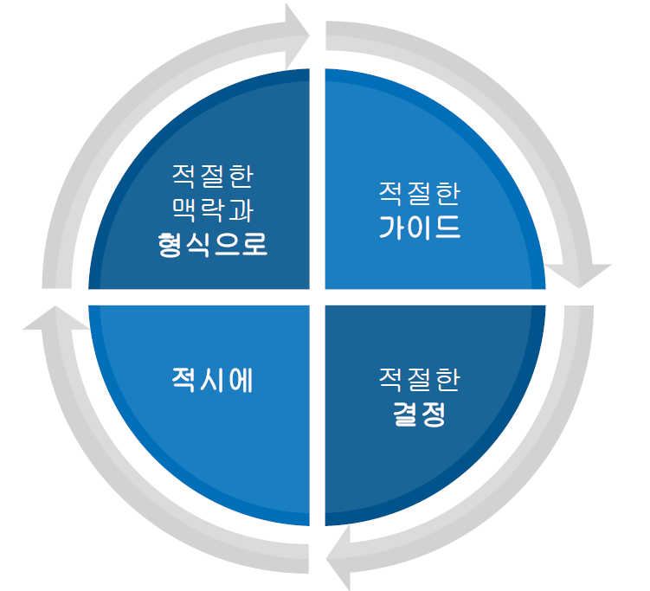
Why do doctors trust UpToDate?

Slide 8
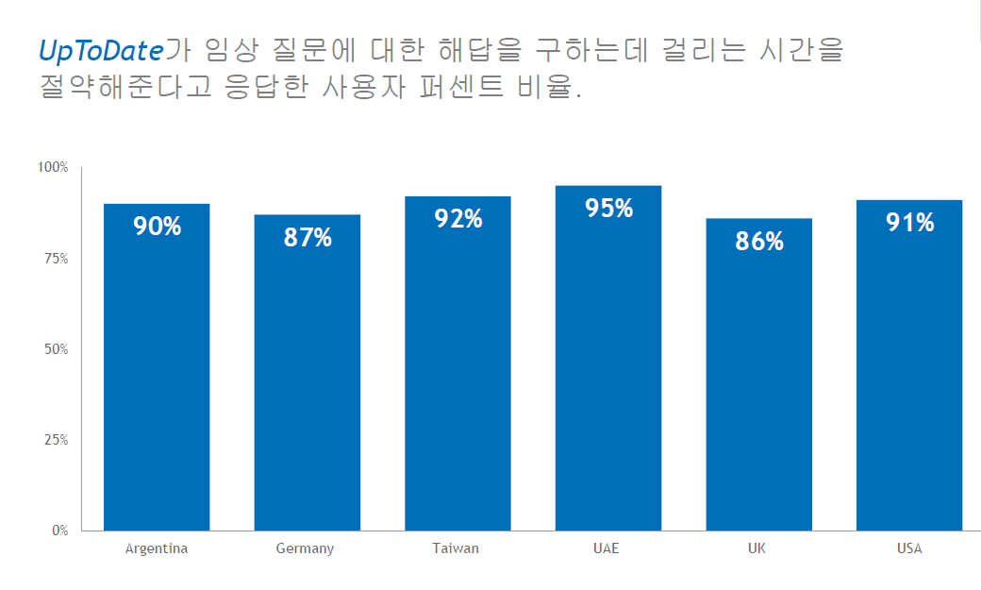
Why do doctors trust UpToDate?

Slide 9
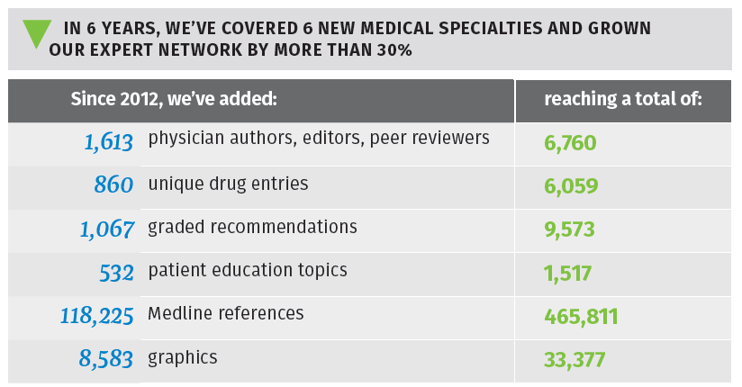
Why do doctors trust UpToDate?

Slide 10

Why do doctors trust UpToDate?

Slide 11
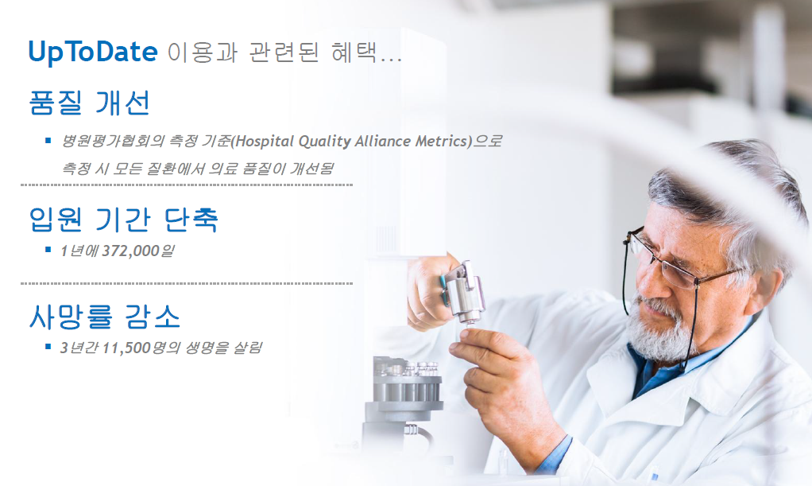

Why do doctors trust UpToDate?

Slide 12
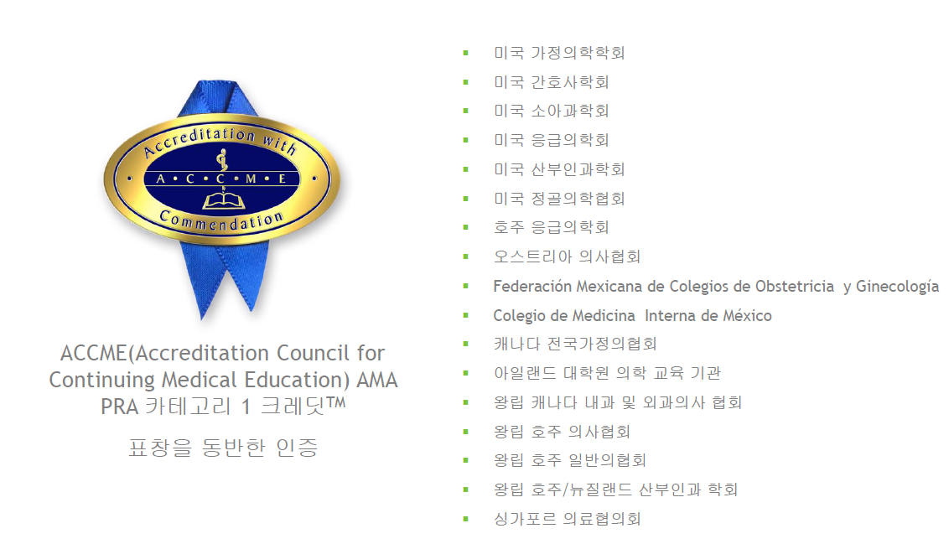
Why do doctors trust UpToDate?

Slide 13
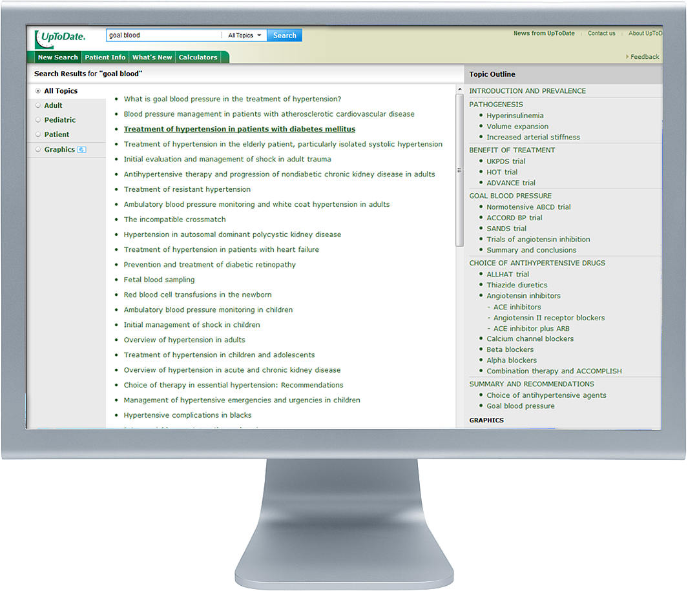
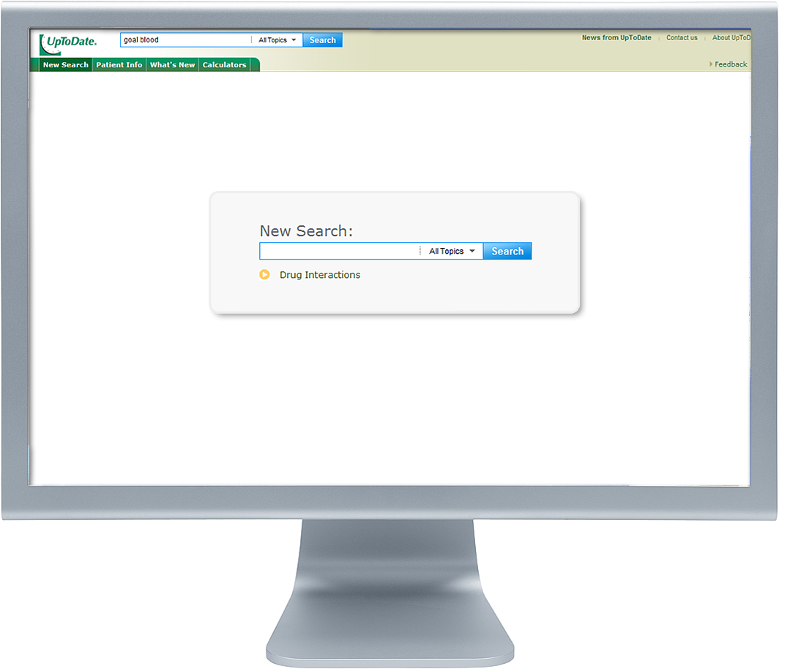

UpToDate Product Demo
goal blood

Slide 14
UpToDate Product Demo
Symptoms, disease, drug, lab abnormality, procedure, medical abbreviation,
search phrase that you want to see
taxis
appendicitis
Leuprolide
abdominal wall defects
hemorrhoids
paraesophageal hernia
colon cancer
prostate cancer
bladder cancer
thyroid cancer
pancreatic cancer
urothelial (transitional cell) carcinoma of the bladder

Slide 15
UpToDate Product Demo
Leuprolide
appendicitis in pregnancy
Component separation repair of large or complex abdominal wall defects
Overview of the treatment of hemorrhoids
Surgical management of paraesophageal hernia
The latest guidelines for colon cancer
External beam radiation therapy for localized prostate cancer
Duration of adjuvant endocrine therapy for bladder cancer
The updated WHO guidelines for appendicitis
Overview of approach to long-term survivors of colon cancer
Overview of the initial approach and management of bladder cancer
Epidemiology and risk factors of urothelial (transitional cell) carcinoma of the bladder
Overview of the management of primary colon cancer/ thyroid cancer/bladder cancer in older adults
Overview of the initial evaluation or prognosis of pancreatic cancer/prostate cancer
Overview of surgery in the treatment of pancreatic cancer/prostate cancer

Slide 16
UpToDate Product Demo
HPV vaccine dossing
The latest guidelines for Crohn disease
Duration of adjuvant endocrine therapy for breast cancer
The updated WHO guidelines for pancreatic cancer
Overview of the treatment of head and neck cancer
Overview of approach to long-term survivors of head and neck cancer
Overview of the initial approach and management of disease
Overview of the management of primary colon cancer/ thyroid cancer/bladder cancer in older adults
Overview of the initial evaluation or prognosis of lung cancer
Overview of surgery in the treatment of pancreatic cancer/prostate cancer

Slide 17
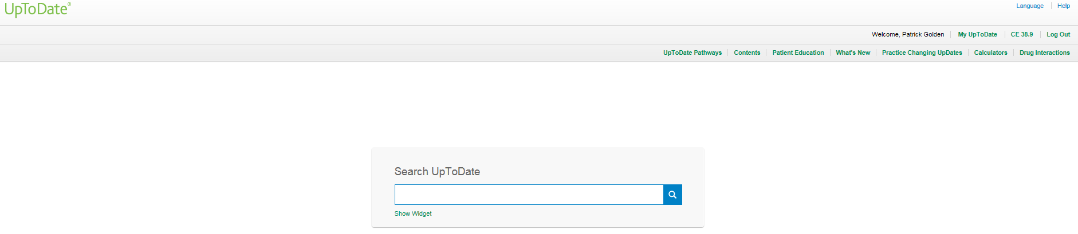
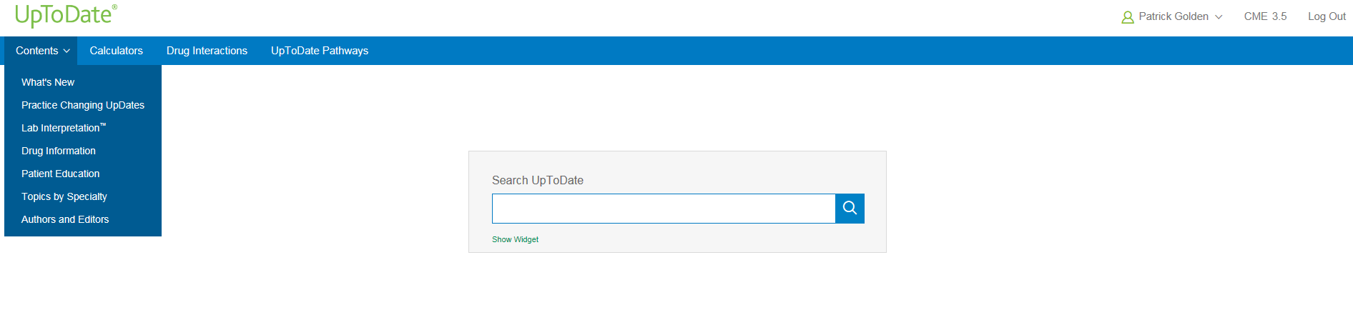
PC 화면
업투데이트 접속시 메인화면이 아래와 같이 변경되었습니다.
파란색 도구 툴바가 있어 기본적인 도구로 즉시 이동할 수 있습니다.

Slide 18
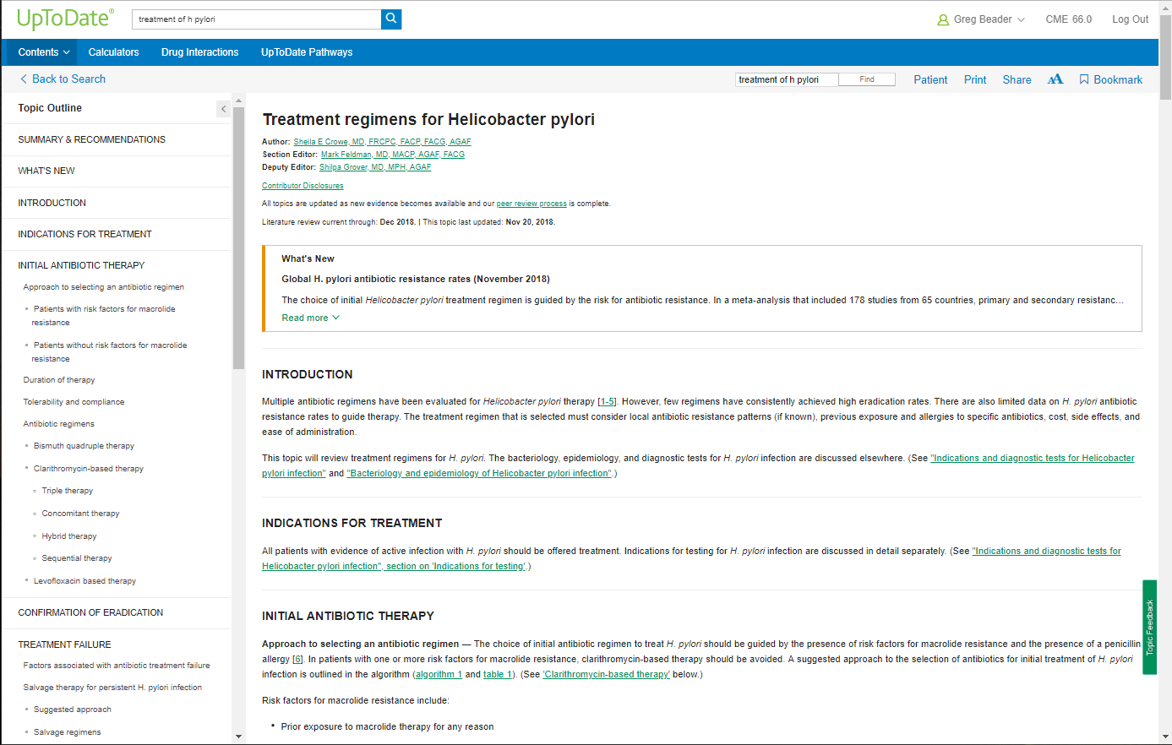
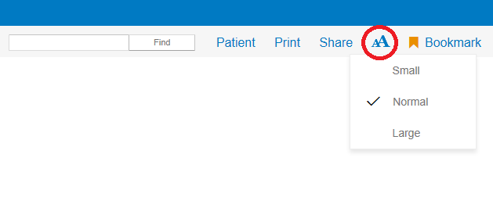
컨텐츠 리뷰 시 토픽과 토픽 간의 여백을 두어 사용자의 리뷰 편의성을 높였습니다.
사용자가 직접 를 눌러 글자 크기를 조절할 수 있어 리뷰 편의성이 향상되었습니다.
Notes:
Presenter notes: Within topics, line spacing and the font size have increased to improve readability. Formatting changes have also been made to improve scanability. For example, the section you click on from the topic outline in now highlighted.
Users have the option to adjust the font size, directly from the menu bar. One of the options returns the font to the default font size used in the previous UI/UX

Slide 19
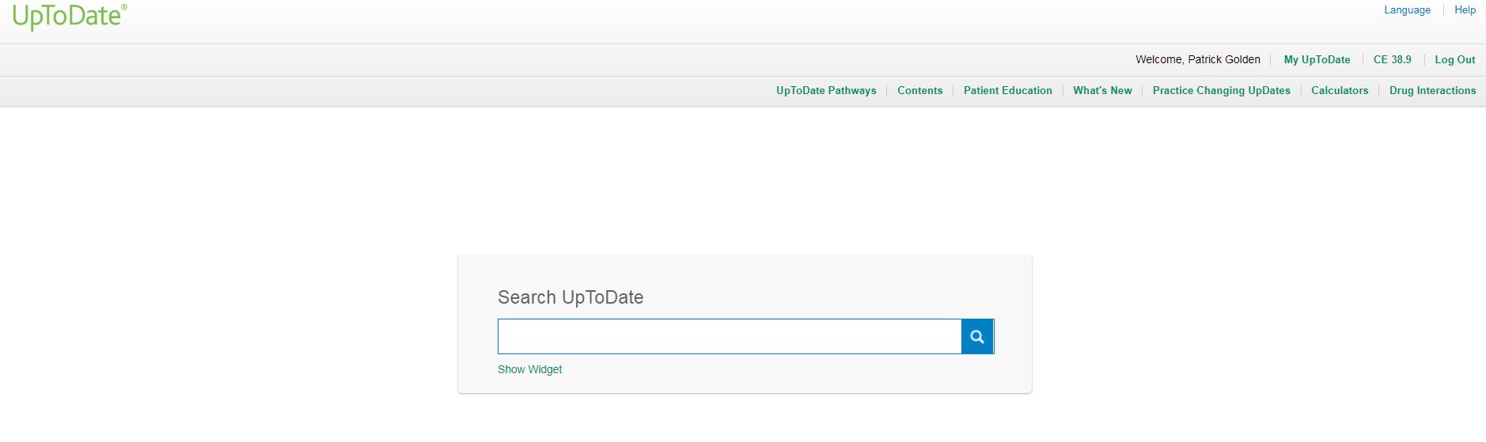
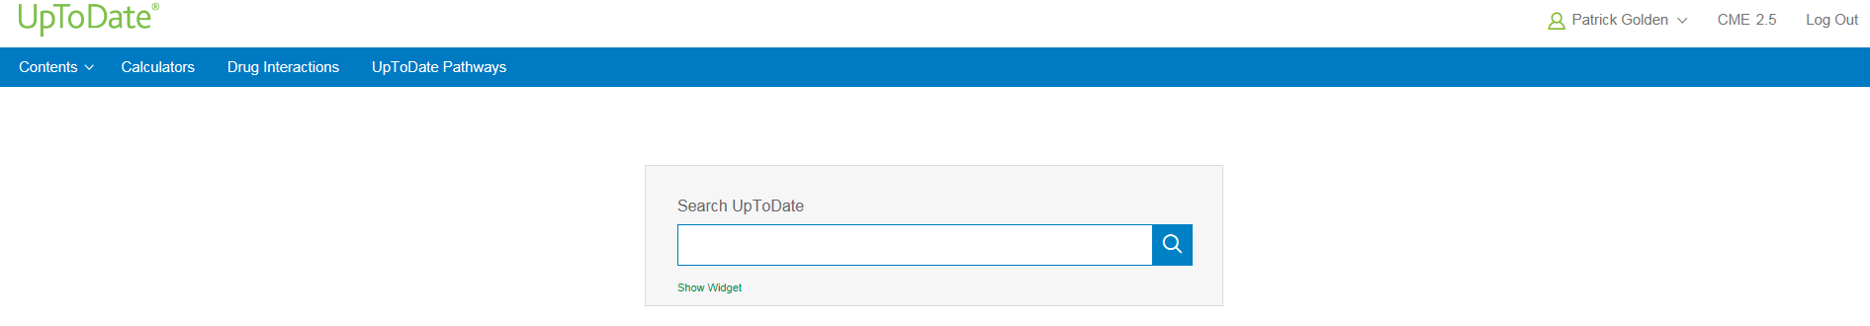
메인 화면에 보이는 파란색 도구 툴바에는 Contents, Calculators, Drug Interactions 같은 기본적인 도구만 나열하였습니다.
Notes:
Presenter notes:
Note that the header information takes up less real estate. The new version is narrower.
There are fewer links to click. The design is clearer, more streamlined, and design to help user access the most relevant links.

Slide 20
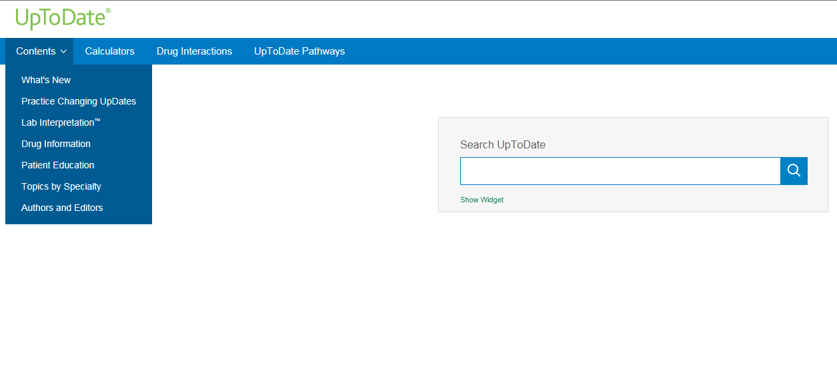
What’s New, Practice Changing UpDates, Drug Information, Patient Education 같은 일부 링크는 Contents 메뉴 안에 있습니다.
Notes:
Presenter notes:
Users will likely first notice the new color scheme, which features a blue navigation bar. Blue has been incorporated in other parts of the design, but the green that users are accustomed to is still present.
The header has a fresh look and links and have been consolidated to focus on what’s most important to users.
A dropdown menu (contents) allows you to select from a variety of other UpToDate resources, such as Drug Information and Practice Changing UpDates.
Lab Interpretation has been added to the drop down menu. In the previous design, Lab Interpretation could accessed within the Contents page.
The Topics by Specialty link is new. It was previously called Contents, and brought the user to a page with information other than the specialties covered by UpToDate. For example, it included What’s New, Authors and Editors, and Practice Changing UpDates. The new page is more focused – it includes only links to each of UpToDate’s 25 specialties.

Slide 21
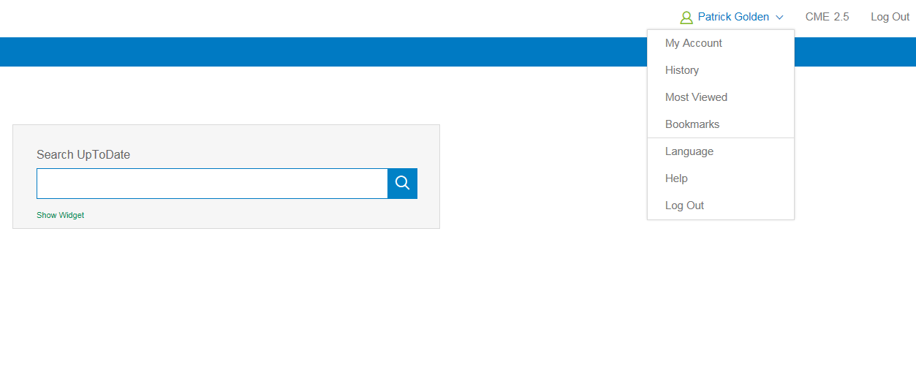
사용자 이름을 누르면 나의 계정 관리, 검색이력, 가장 많은 조회, 책갈피, 언어 변환, 도움말, 로그아웃 주요 기능을 이용할 수 있습니다.

Slide 22
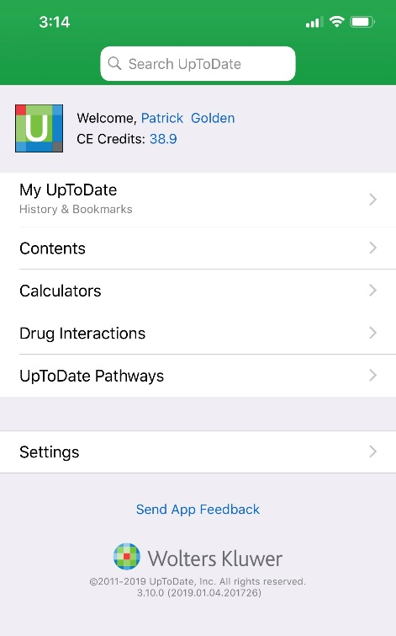
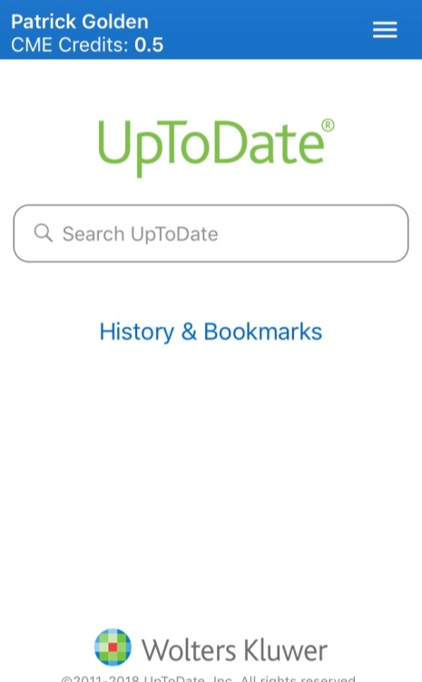
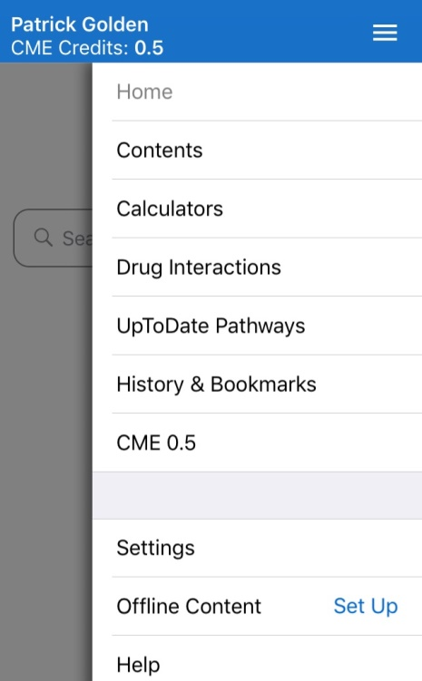

모바일 화면
Previous
New
모바일 업투데이트 접속 시, 우측 상단의 버튼을 눌러서 메뉴를 확인할 수 있습니다.

Slide 23
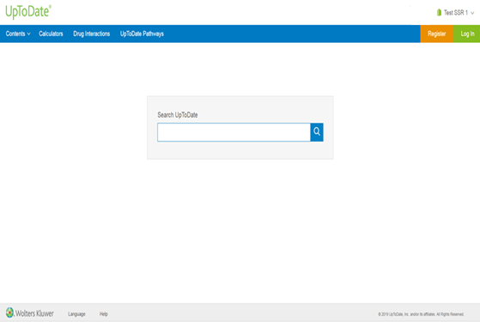
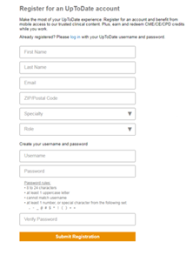
개인 계정 등록 절차
개인 계정 등록을 위하여 기관 접속이 된 PC에서 오렌지색 Register 를 클릭합니다.
개인 계정 등록지 작성을 완료합니다.
Username은 개인 아이디, Password는 8자 이상 (대문자, 숫자 1개 이상 포함)입니다.

Slide 24
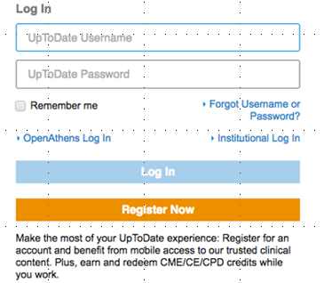
개인 계정이 이미 있는 유저는 우측상단 클릭 후 로그인합니다.
90일에 한번씩 기관 PC 업투데이트홈페이지에서 개인 계정 로그인이 필요합니다.

Slide 25
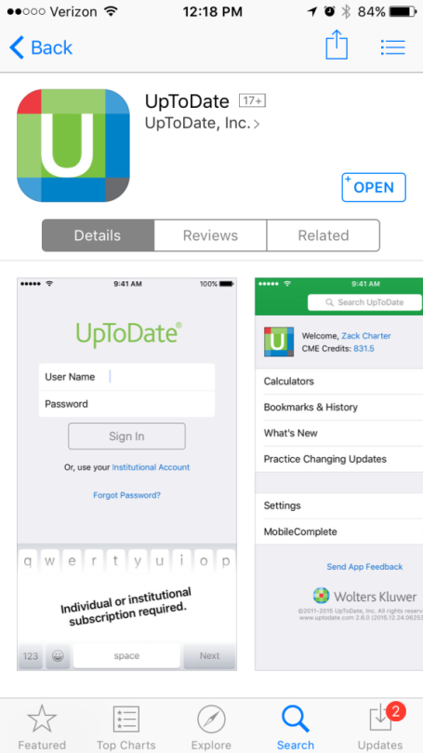
Download the Mobile App
    Go to your App Store
    Search: UpToDate
    Click on the UpToDate icon
    Download App
    Enter your UN/PW the first
    time you access the App

Slide 26
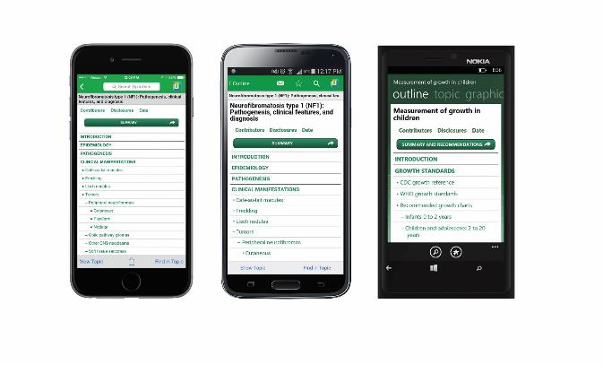
Award-Winning UpToDate Mobile App
Clinicians can now download and use one of “The Best Apps in Publishing” according to EContent Magazine

Slide 27

UpToDate - Anytime, Anywhere & From Mobile Devices
Direct access to UpToDate from any internet browser
The UpToDate Mobile App for iOS and Android™
CME/CE/CPD credits and continuing education tracking may be earned whenever and wherever clinicians research a clinical question

Slide 28
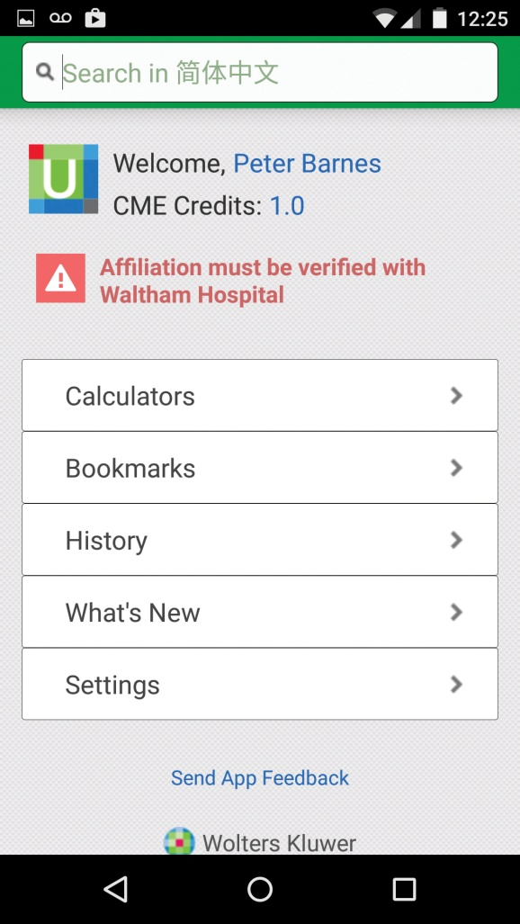
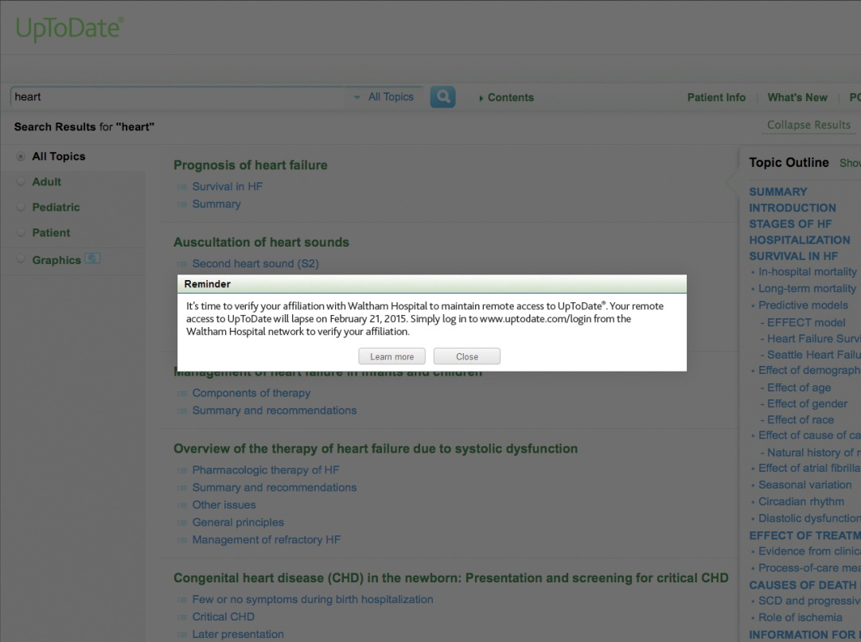
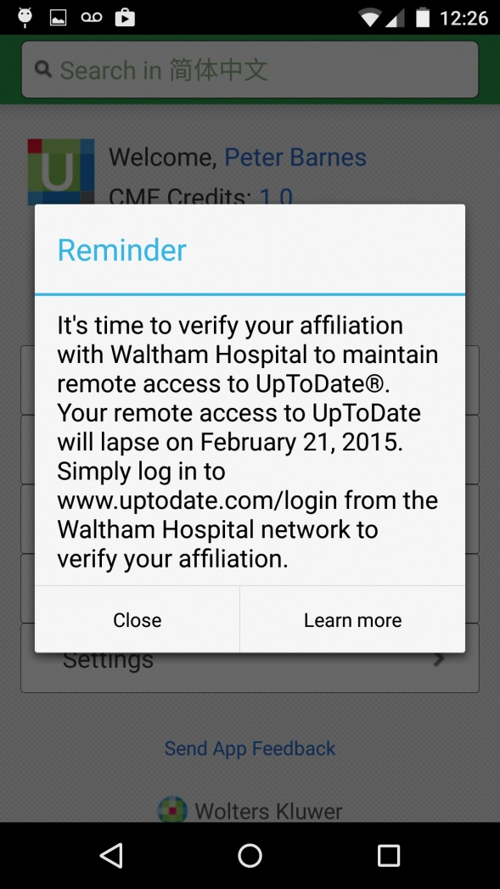
90 Day Re-Verification
In-application & email messaging reminds clinicians to verify their affiliation with the organization to maintain remote access rights

Slide 29
감사합니다.
문의사항은 아래 메일로 보내주십시오.
grace.jeong@wolterskluwer.com

